Slide 1

Slide 01
Smart Security:
Computer Vision Threat Detection
Team APERTURE
(IIT KANPUR)

Slide 2


Team Aperture
Slide 02
Problem statement
Detection of suspicious, violent activities from CCTV footage, including unusual movements, altercations, dangerous actions, and presence of weapons.
Impact
This can be widely used in places like airports and high crowd places like shopping complexes where manual CCTV checking for suspicious activities is not possible.

Slide 3

Team Aperture
Slide 03
Solution overview
We have taken a two-fold approach to tackle this problem -
i) Detecting fights/altercations - Using LRCN & VIVIT models
ii)Detecting weapons - Using YOLOv8 model
We will finally build a combined ensemble model which will incorporate all these 3 models.

Slide 4

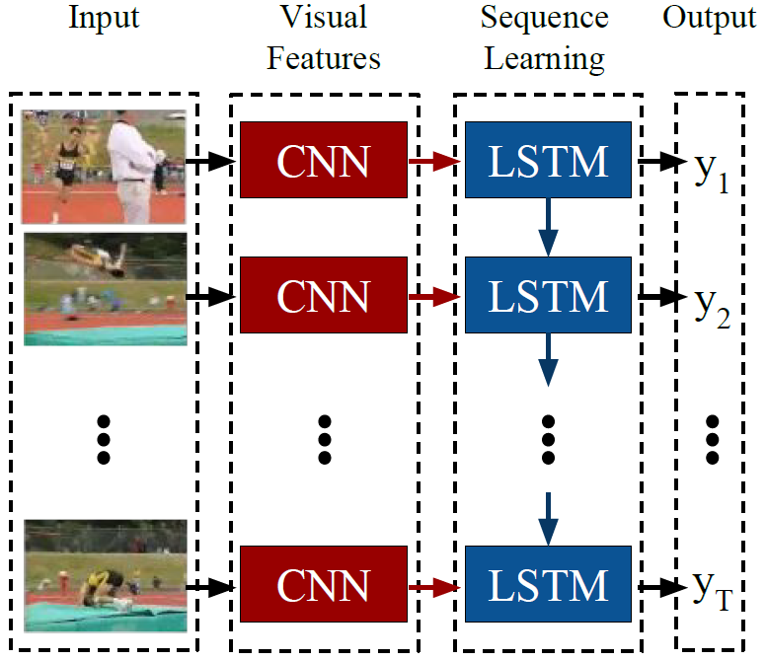
Team Aperture
Slide 04
LRCN model
LRCN stands for Long-term Recurrent Convolutional Network - a revolutionary architecture which combines CNNs with LSTMs!
LRCNs use several CNNs to learn visual features from video frames and then pass their outputs to LSTMs, which transform a sequence of image embeddings into probabilities or class labels.
We used the Real Life Violence Situations Dataset from Kaggle, which consists of 1000 fight and 1000 non-fight videos. We extracted frames from each video, and passed them through standard CNN, MaxPooling, LSTM and Dense layers. Our model accordingly classifies the clip as ‘NonViolence’ or ‘Violence’.
We finally obtained a test accuracy of 89.4%.

Slide 5
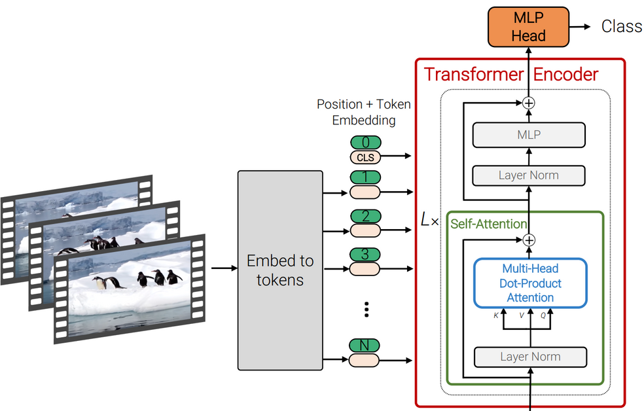
Team Aperture
Slide 05
Vivit:A TransformeR
ViViT (Video Vision Transformer) is a model that uses the state-of-the-art Transformer Architecture for video classification. We first use CNN models for feature extraction frame-by-frame, and then the transformer is used to classify the video.
We are processing video framewise, using MobileNetV3 for feature extraction. Then we are passing it through standard transformer layers like Positional Encoding, MultiHead Attention, and FeedForward etc. Finally we have an MLP classification layer which did the binary classification task.
We trained it on the same dataset as mentioned above, and recieved a test accuracy of 85%

Slide 6
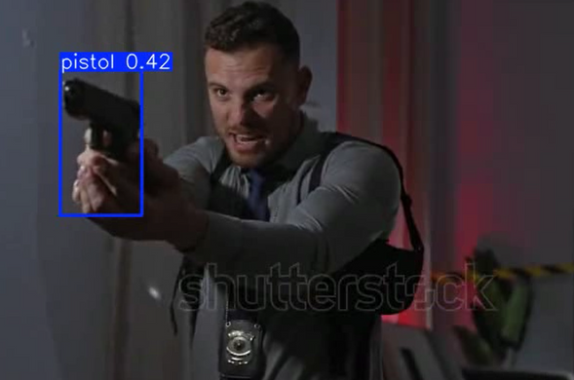
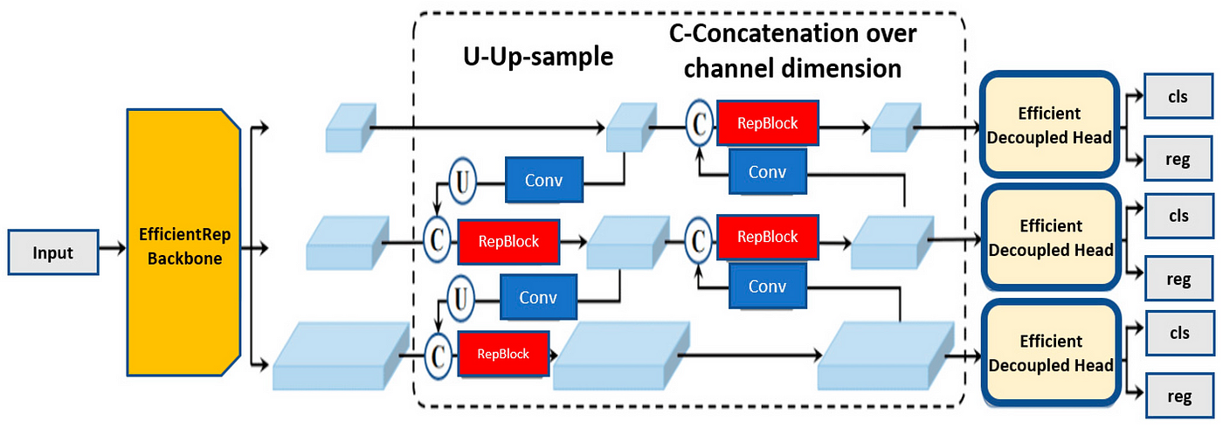
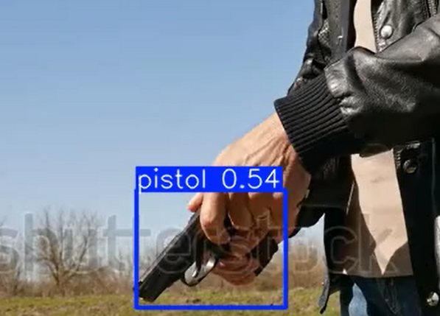
Team Aperture
Slide 06
YOLO-V8
YOLO (You Only Look Once) is a real-time object detection model that predicts bounding boxes and class probabilities for multiple objects in image in a single forward pass. We trained a YOLO - V8 model for weapon detection, which can detect weapons of classes like pistols and bombs. For the training purpose we used a labelled dataset from ROBOFLOW (https://universe.roboflow.com/em2023/gun-detection-s5poj/dataset/1)

Slide 7

Team Aperture
Slide 07
Conclusion
We have deployed a Streamlit frontend with all these 3 models in the backend. The user has the option of choosing between LRCN and VIVIT for fight detection, while YOLOv8 is always the default for weapons detection.
The output wil be flagged “SUSPICIOUS” if either fights are detected OR weapons are detected.
Our innovative solution can be integrated easily with CCTVs to conduct real time smart surveillance, greatly enhancing security in high-stakes public spaces.

Slide 8


Team:
Slide 08
Team Aperture
Shlok Jain
Aritra Ray
Aayush Kumar
Joel Bansal
Thank You
IIT KANPUR

